Slide 1
CFPB Application Update Request (with further clarifications on 2014-10-27)
The following steps are required to expedite the “role-based” updates needed to support our DCI customer as they roll out the CFPB application to hundreds of additional users on their team. . . .
Add new roles as specified (see page 2)
Add capability to create new users using the “new roles” (see page 3)
Update the “aspnet_users” table to include a column called “ManagerId”
This will be populated with the UserId of the associated manager when the user role of “AgencyCollector” is created
Create a new table grid for “Filtered Complaints” (see page 4)
We need a new table grid of complaints that can be filtered by the “AgencyCollector” individuals that report to a specific AgencyManager
The FIRST filter box is to select the “AgencyManager”
If the logged in user is an “AgencyManager”, then their name will appear by default
If the logged in user is an “AgencyCompliance” user, then the complete list of the “AgencyManager” users will appear in this filter box displayed as “LastName, FirstName” and should be sorted in alphabetical order by last name, then first name
The filter box will display a “multi-select” drop-down so the user can choose one or “many” of the listed users
The SECOND filter box is to select the “AgencyCollector”
This should ONLY display the “AgencyCollector” users that report to the selected “AgencyManager” in the first filter box and should be displayed as “LastName, FirstName” in alphabetical order by last name, then first name
The filter box will display a “multi-select” drop-down so the user can choose one or “many” of the listed users
The ONLY complaints that should appear in this table grid are NON-RESOLVED complaints for the users as selected from Filter Box 1 and 2
Andy will manage the display of the table grid page (as shown on page 4) for the “AgencyManager” and “AgencyCompliance” roles
Update the “Tbl_ComplaintMain” with a column for “AgencyCollectorId” so that the complaint can be assigned to a specific “AgencyCollector” user which will enable the capability for displaying those complaints that are “assigned” to a specific “AgencyCollector” user
Create a new table grid for “Escalated Complaints” (see page 5)
A new complaint status (EC) has been created which stands for “Escalated Complaint”
CLARIFICATION – The ONLY complaints that should appear in this table grid are those with a status of “Escalated Complaint”
NO CODE CHANGE is required to handle the updating of the complaints in and out of “Escalated” status (Andy will have a script run every day that will conduct a “date check” to identify and update those complaints that need to be escalated)
Create a new “table grid” page that is similar to the existing “New Complaints in Progress” (note the updated columns as shown on the screen shot on Page 4)
Andy will manage the display of the table grid page (as shown on page 5) for the “AgencyCompliance” role
Allow for “manual” complaint creation (see page 6)
There may be times when the complaint is not based upon an existing account and DCI has to create a complaint “manually”
Everything already works to have the “Consumer & Debt Information” section update the “Account” record - - the only issue is the requirement to have a “Complaint ID” assigned to the complaint before saving
Because the logic already exists to concatenate the “Agency Name”, the “last 3 of the account number” and “a random number” to make the Unique Complaint ID - - I recommend the following:
Allow the user to enter the data into the fields as needed
When the user clicks the “Save” button, use the information from the “Agency Name” field and the “Consumer Account” field as well as your “random number generator” to create the unique “Complaint ID” as the complaint is being created and saved

Slide 2
Add New Roles
Page 2
Existing Role | Existing Role Functionality | Add New Role Name | Functionality for New Role Name
CollectionAgency | Ability to create a complaint Visibility to all left navigation workflow Visibility to all complaints based on existing “Agency” workflow status Visibility to Complaint Sections: Consumer & Debt Information Complaint Information Collection Agency Process Complaint Closure NO visibility to Complaint Section: Manager Process | AgencyCollector | Copy of “CollectionAgency” role Ability to create a complaint Visibility to all left navigation workflow Visibility to all complaints based on existing “Agency” workflow status Visibility to Complaint Sections: Consumer & Debt Information Complaint Information Collection Agency Process Complaint Closure NO visibility to Complaint Section: Manager Process NO CODE CHANGES REQUIRED
DebtOwner | Visibility to applicable left navigation workflow (as updated by Andy) Visibility to applicable complaints based on existing “Owner” workflow status Visibility to Complaint Sections: Consumer & Debt Information Complaint Information Collection Agency Process Manager Process (allows for providing complaint adjudication) Complaint Closure | AgencyManager | Copy of “DebtOwner” role Visibility to ALL left navigation workflow (this will be updated by Andy) Visibility to applicable complaints based on existing “Owner” workflow status Visibility to ALL Complaint Sections: Consumer & Debt Information Complaint Information Collection Agency Process Manager Process (allows for providing complaint adjudication) Complaint Closure NO CODE CHANGES REQUIRED
 |  | AgencyCompliance | Copy of “DebtOwner” role Visibility to ALL left navigation workflow, including NEW “Escalated Complaints” menu option (this will be updated by Andy) Visibility to applicable complaints based on existing “Owner” workflow status Visibility to ALL Complaint Sections Visibility to NEW “Escalated Complaints” table grid CODE CHANGE – ADD “Escalated Complaints” table grid

Slide 3
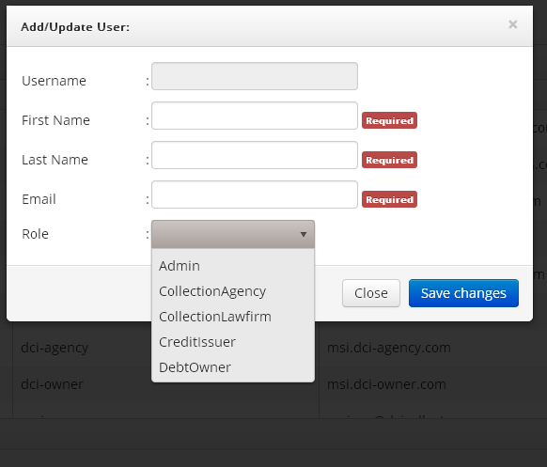
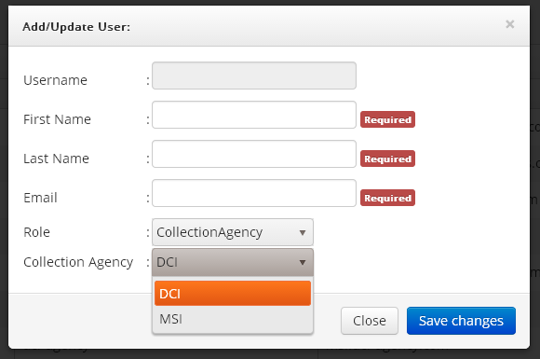


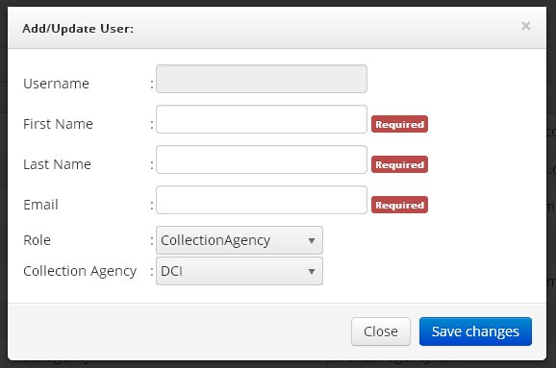
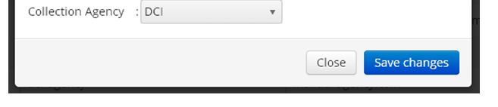
Add New Role Creation Capability
Page 3
or Select “AgencyManager” or “AgencyCompliance”
AgencyCollector
“DCI” will be the Collection Agency
AgencyCollector
AgencyManager
AgencyCompliance
New role names from “aspnet_roles” table
ONLY when “AgencyCollector” is selected and “Collection Agency” is DCI
THEN - - Provide additional drop-down selection to choose the appropriate “AgencyManager” for the “AgencyCollector” user being created
AgencyCollector
AgencyManager
Howard, James
Martin, Steve
Smith, John
Example list of possible “AgencyManager” names - - they should be displayed in this manner with data pulled from “aspnet_users” table

Slide 4
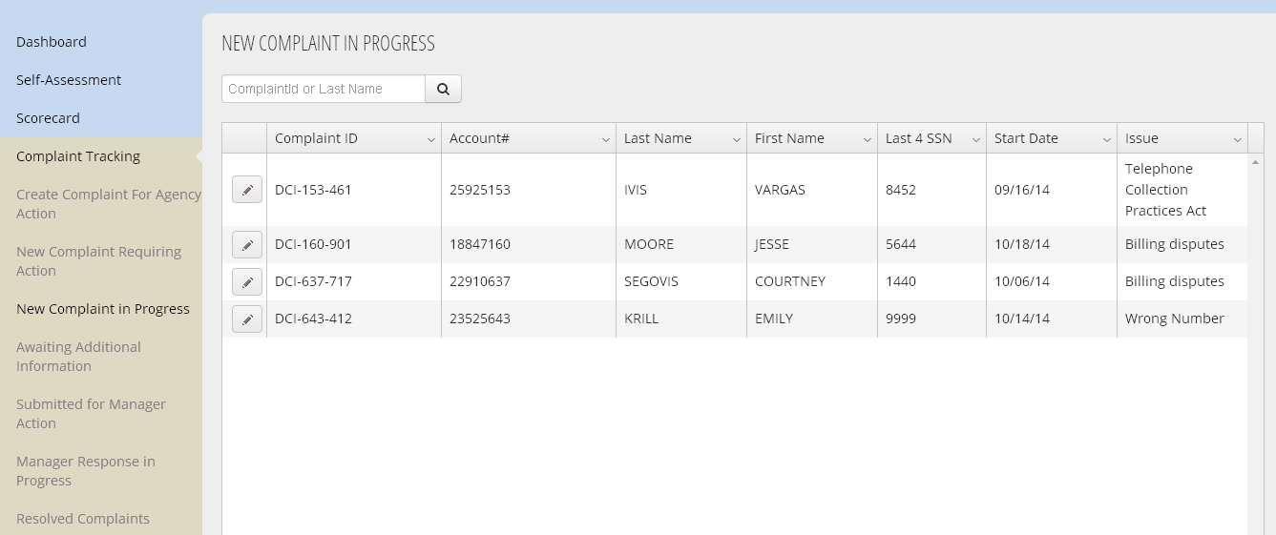
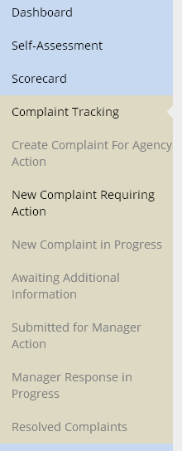
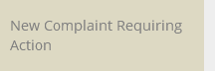
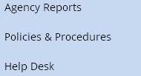
Create New “Filtered Complaints” Table Grid
Page 4
Once the “AgencyManager” is selected, this should be a drop down list of ONLY those AgencyCollector staff that report to that AgencyManager. The list should be displayed LastName, FirstName in alphabetical order by “Last Name” and then “First Name”
If an “AgencyManager” is logged in, their name will appear here by default
This should be the “UpdatedDateTime” field from “Tbl_ComplaintMain”
FILTERED COMPLAINTS
Select Agency Manager . . .
Select Agency Collector. . .
Agent Name
Updated Date
Smith, John
10/19/14
Smith, John
10/19/14
Smith, John
10/19/14
Smith, John
Filtered Complaints
New column added into existing “New Complaint in Progress” table grid
New column added into existing “New Complaint in Progress” table grid
Andy will get this added to the left navigation menu for the appropriate users

Slide 5
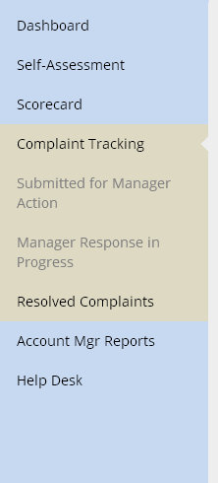
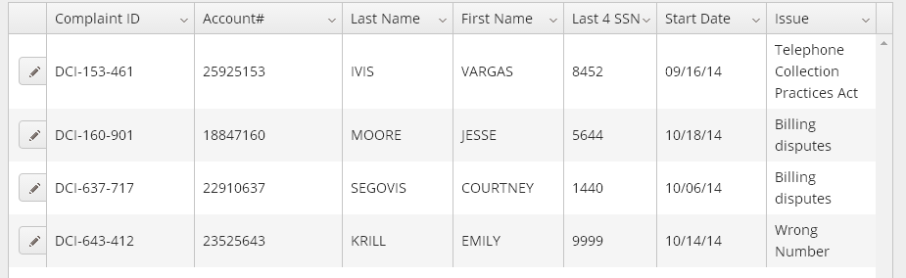
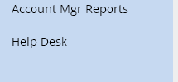
Create New “Escalated Complaints” Table Grid
Page 5
This should be the “UpdatedDateTime” field from “Tbl_ComplaintMain”
This should be the name of the user (formatted and displayed as shown here) identified in the “UpdatedBy” field from “Tbl_ComplaintMain”
ESCALATED COMPLAINTS
Updated Date
Updated By
10/21/14
Smith, John
Filtered Complaints
10/21/14
Smith, John
Escalated Complaints
10/21/14
Smith, John
10/21/14
Smith, John
Andy will get this added to the left navigation menu for the appropriate users
New columns added into existing “New Complaint in Progress” table grid

Slide 6
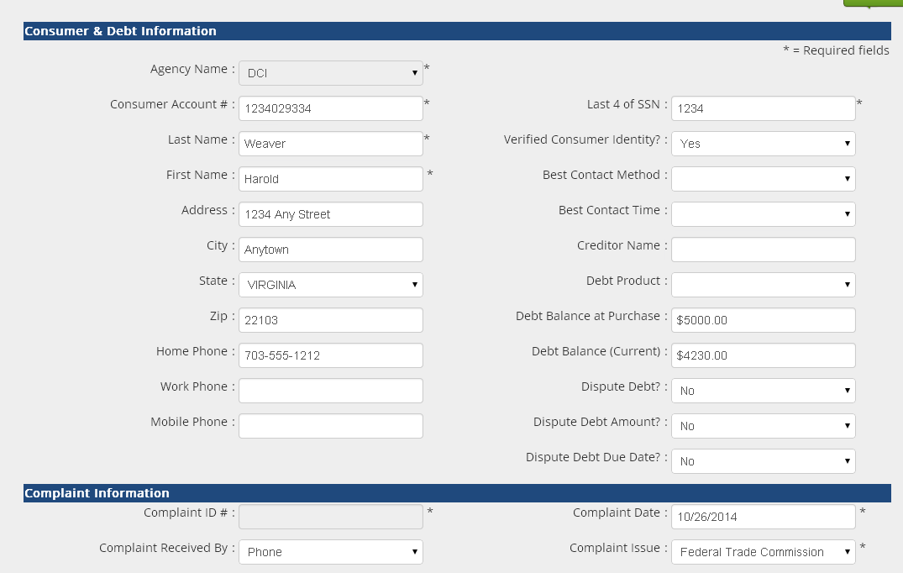

Allow “manual” complaint creation
Page 6
This is the “default” since the user is with the DCI Agency
Upon “saving” the record, use your existing logic to concatenate the “Agency Name”, “last 3 of Account #” and “a random number” to create the unique “Complaint ID”
DCI-334-nnnn

